Slide 1
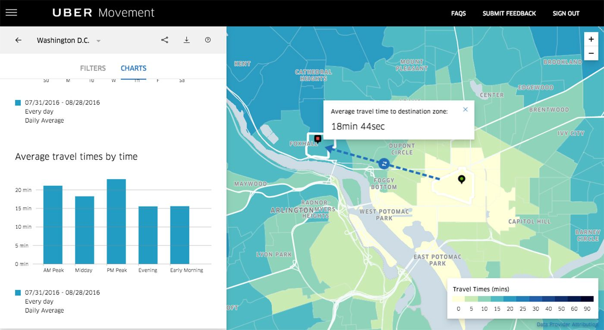
Uber Movement
PREDICTING CAR ACCIDENTS
Team 4: Jun Omiya, Yi-jing Lai, and Stephanie Morton
Presented by: Jun Omiya, Yi-jing Lai, and Stephanie Morton

Slide 2
Probl
em
1.35 million fatalities annually (Global)
Average cost - 1.13 million (death)
Average cost - $61,000 (non - fatal)
Average cost - $7,500 (property damage)
UN’s goal to cut numbers in half by 2020
1 million road accidents, 31.9 fatalities per 100,000 annually - South Africa
2

Slide 3
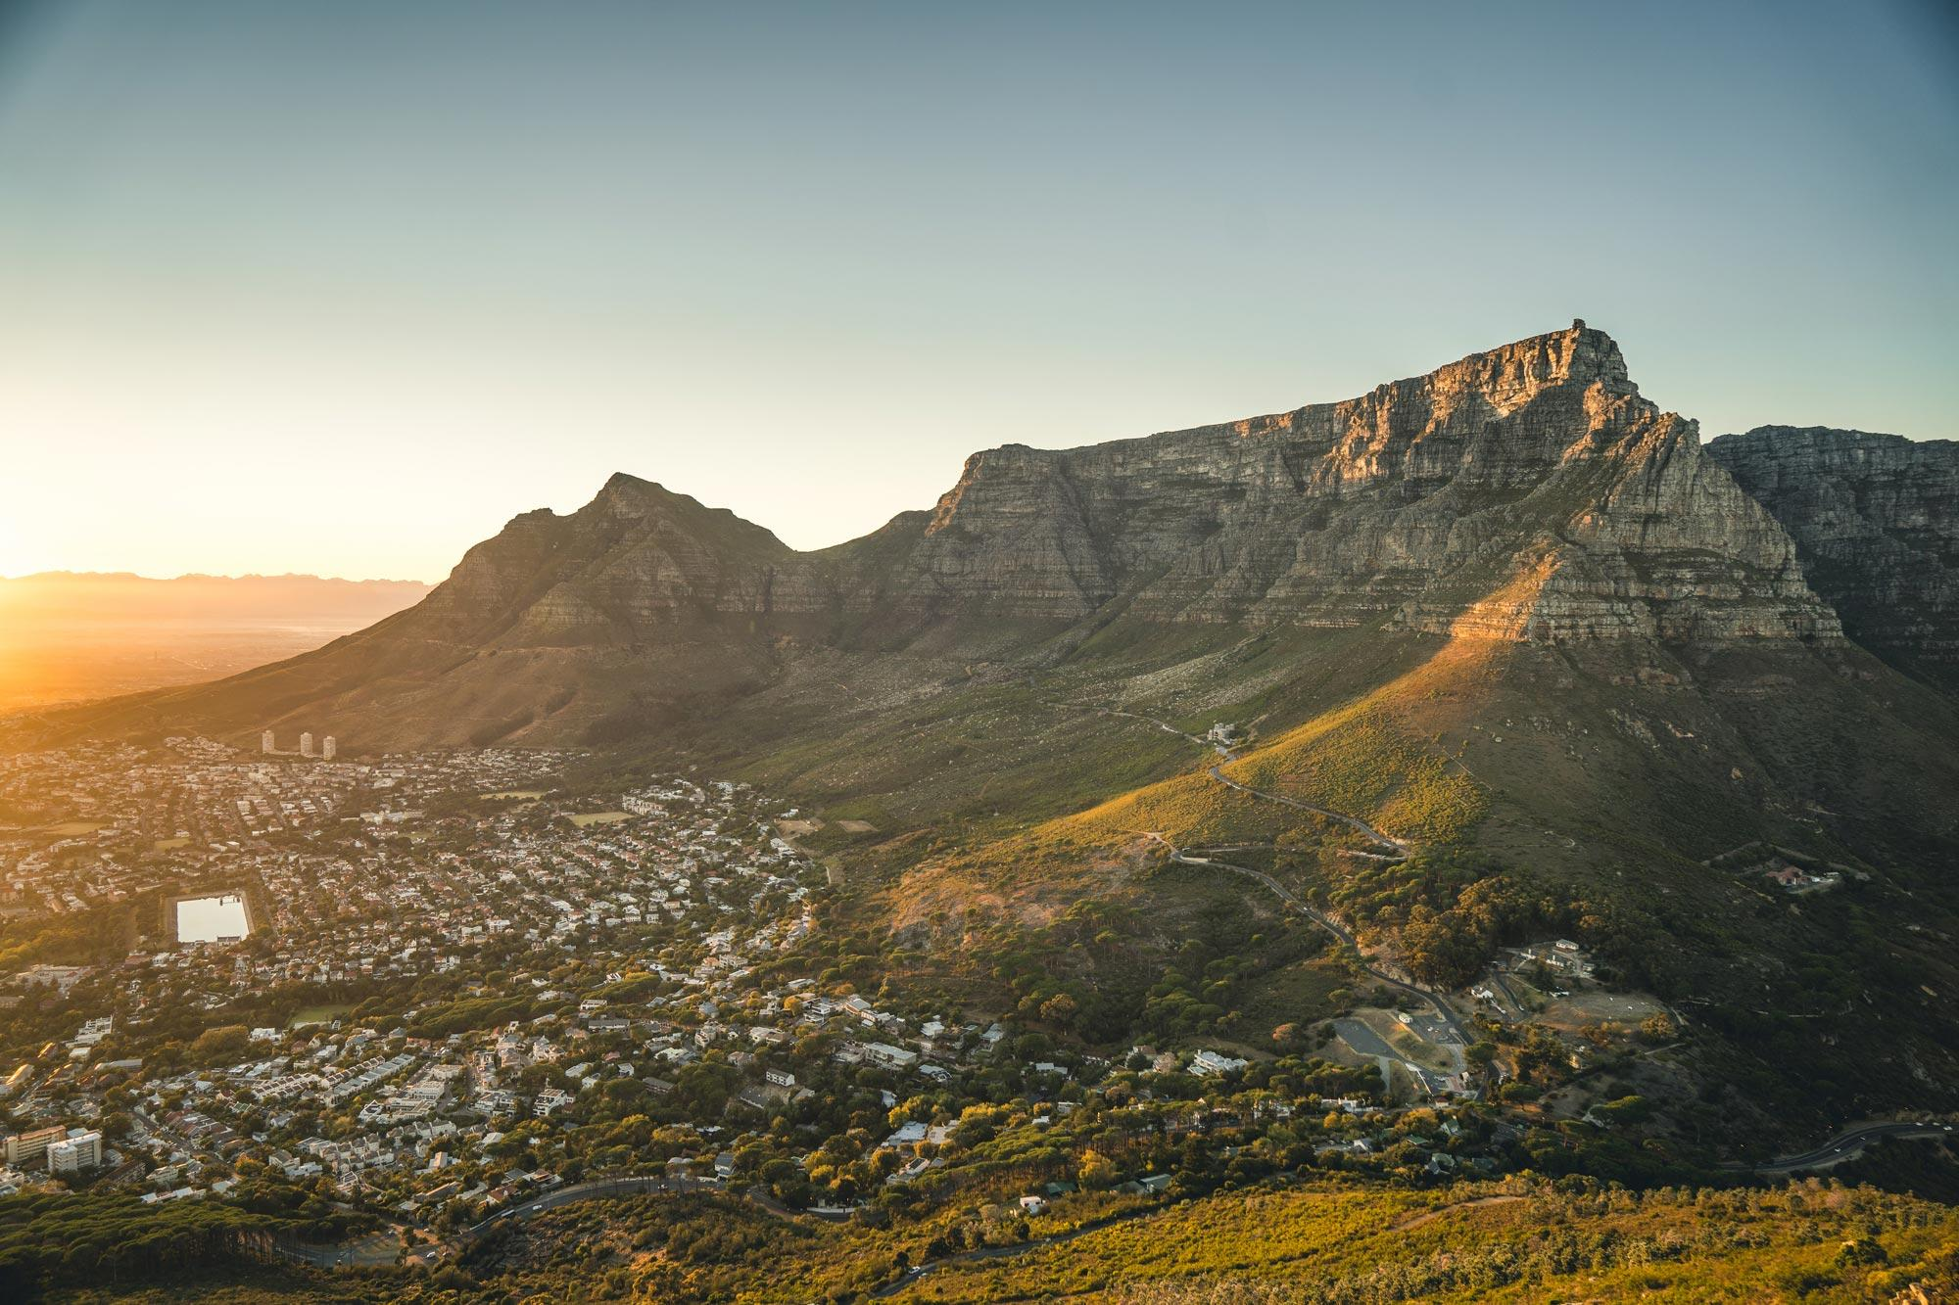
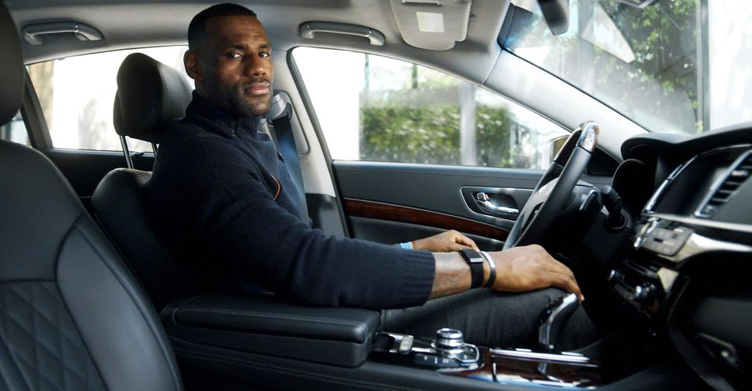
Lebron James, the Uber driver, picks you up at Cape Town Airport
Along the way he gets a call from Connor and comes to an abrupt stop
3
Notes:
Scenario:
Lebron James, your Uber driver, picks you up at Cape Town international Airport to take you to Table Mountain for sunset (6:04 PM GMT +2). As you drive around the beautiful city getting closer and closer, Lebron James gets a mysterious call from Connor Lawless telling Lebron James to stop immediately and not go a foot further as you see a car run a red light going 65 MPH at your intersection. Surprised and thankful, you ask Lebron James, “how did you know to stop?”

Slide 4
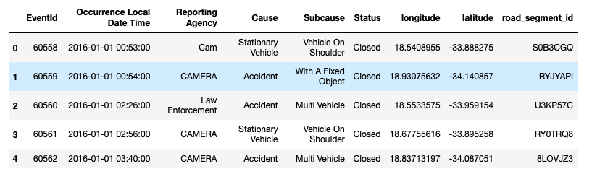
What did Connor use to predict this ?
4
Notes:
Answer:
He predicted an accident by looking at our model that we made.

Slide 5
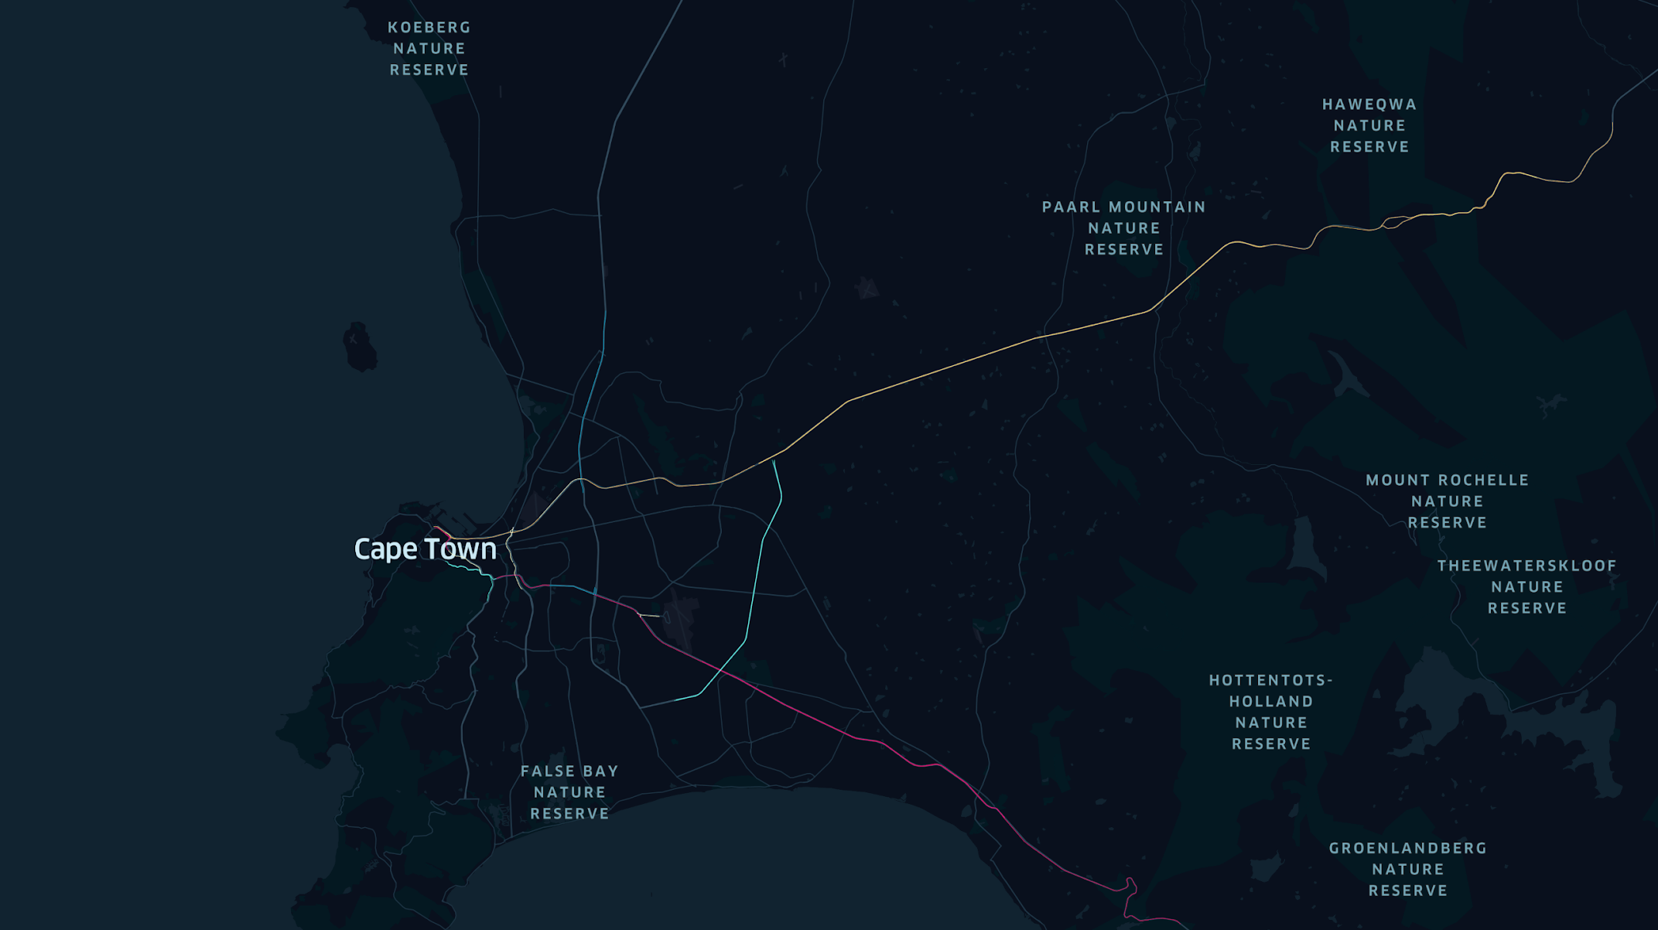
Problem Overview
544 Road Segments
9 Road Numbers
5

Slide 6
Our
Features
Days of Week and Minutes
Weather
Holidays
Road No.
Road Width and Lanes
Latitude
Longitude
Class
Most variables are encoded because they are categorical
6

Slide 7

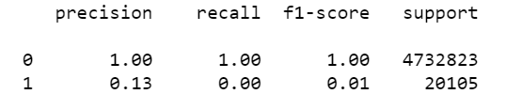
Model: Random Forest
Why
Result
Why
Result
Problem
Problem
Predicting a classification output
Typically more accurate than decision trees
99.6% accuracy
7

Slide 8

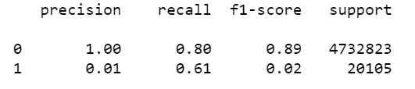
Model: Balanced Random Forest
How
Result
How
Result
Problem
Problem
Used Balanced Random Forest Classifier
Put more weight on minority outcome(accidents happening)
80% of the model predicts when and where the next road incident will be.
Increased recall
Numbers are not as accurate as before
8

Slide 9
How Does This Help
Able to predict an accident
Can utilize predictions to have medical staff ready at certain times
Strategically place law enforcement and health teams
Cut ambulance response time
Saves lives and cost
9

